Slide 1
Marketing Data Science
Internship Summer 2026
SOPHIE KRAJMALNIK
Data Science
May – July 2026
Notes:
Shorten intro – name and role

Slide 2




AzSEF
SARSEF
AZ Invention Convention
Notes:
Mention DARTS

Slide 3
Agenda
What is CIIM?
Project Scope + Background
1
What can we improve?
Workflow + Findings
2
What comes next?
Summary + Recommendations
3
Notes:
Could animate in each section
Bold numbers and titles

Slide 4

CIIM helps to understand the impact of DT ad placement
Cable Incremental Investment Model: maximize web visits from linear TV ads
CIIM Conversion Model:
impressions → sessions at TV x Week level
Notes:
Read the title, then go downwards to explain the name

Slide 5
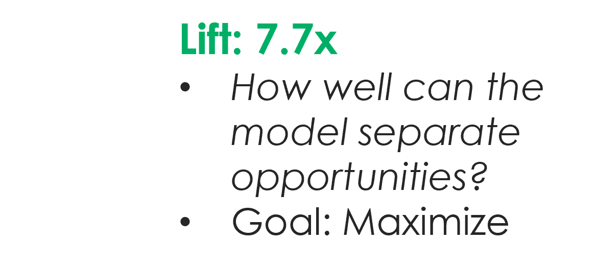
Baseline model uses 4 weekly adstock features

Slide 6
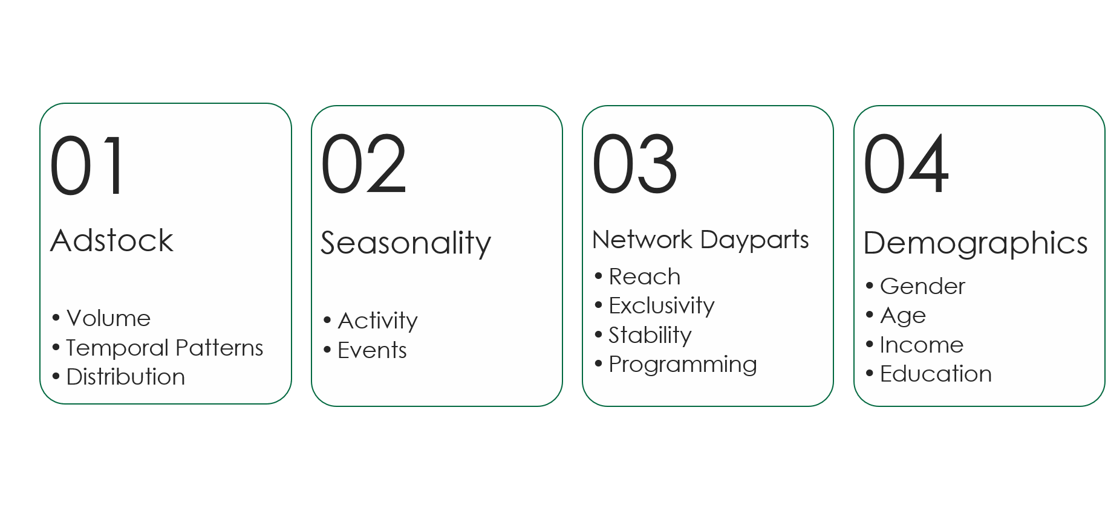
Adding features to the model will increase its predictive power
Adstock
01
Volume
Temporal Patterns
Distribution

Slide 7
Adstock temporal patterns and distribution share were too connected to overall impressions
Build 19 candidate features
Check correlation and signal
Run model iterations with approved features
Notes:
Make white text black

Slide 8
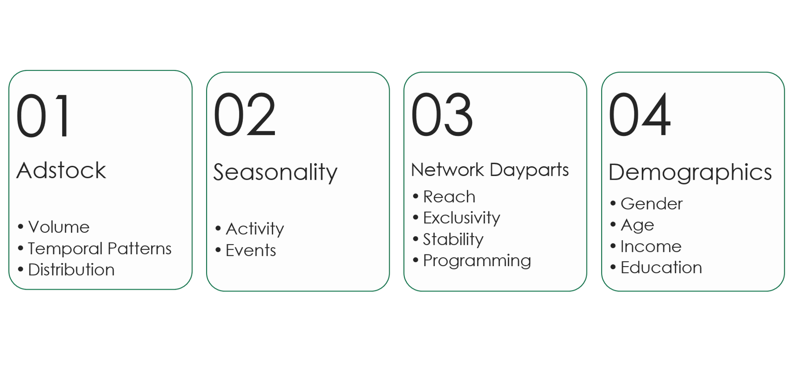
Adding features to the model will increase its predictive power

Slide 9
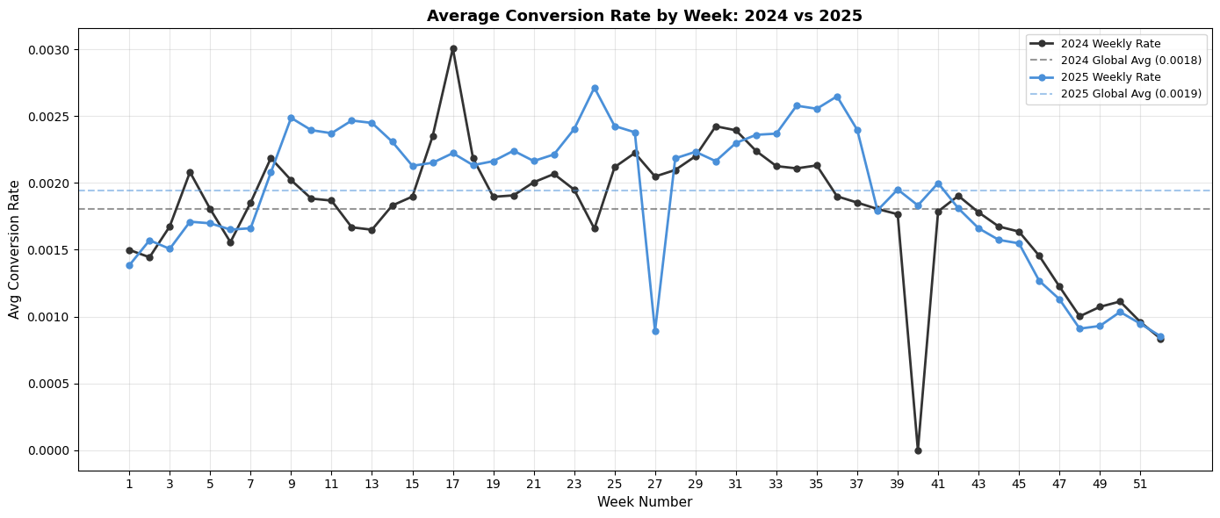
Weekly averages show rough flow of behavior

Slide 10
Quadratic equation captures smooth seasonal expectation
Notes:
Every other number to adjust x axis scaling
Fly in equation

Slide 11
Quadratic equation captures smooth seasonal expectation
y = -2E-06x² + 8E-05x + 0.0013
R² = 0.9119
Notes:
Every other number to adjust x axis scaling
Fly in equation

Slide 12
Top-performing seasonal versions struggle to separate
Model Version | Lift
Baseline | 7.77x
Seasonal 0.25 | 4.76x
Quarter | 6.42x
Notes:
Colors a little challenging, maybe an orange

Slide 13
Adding features to the model will increase its predictive power

Slide 14
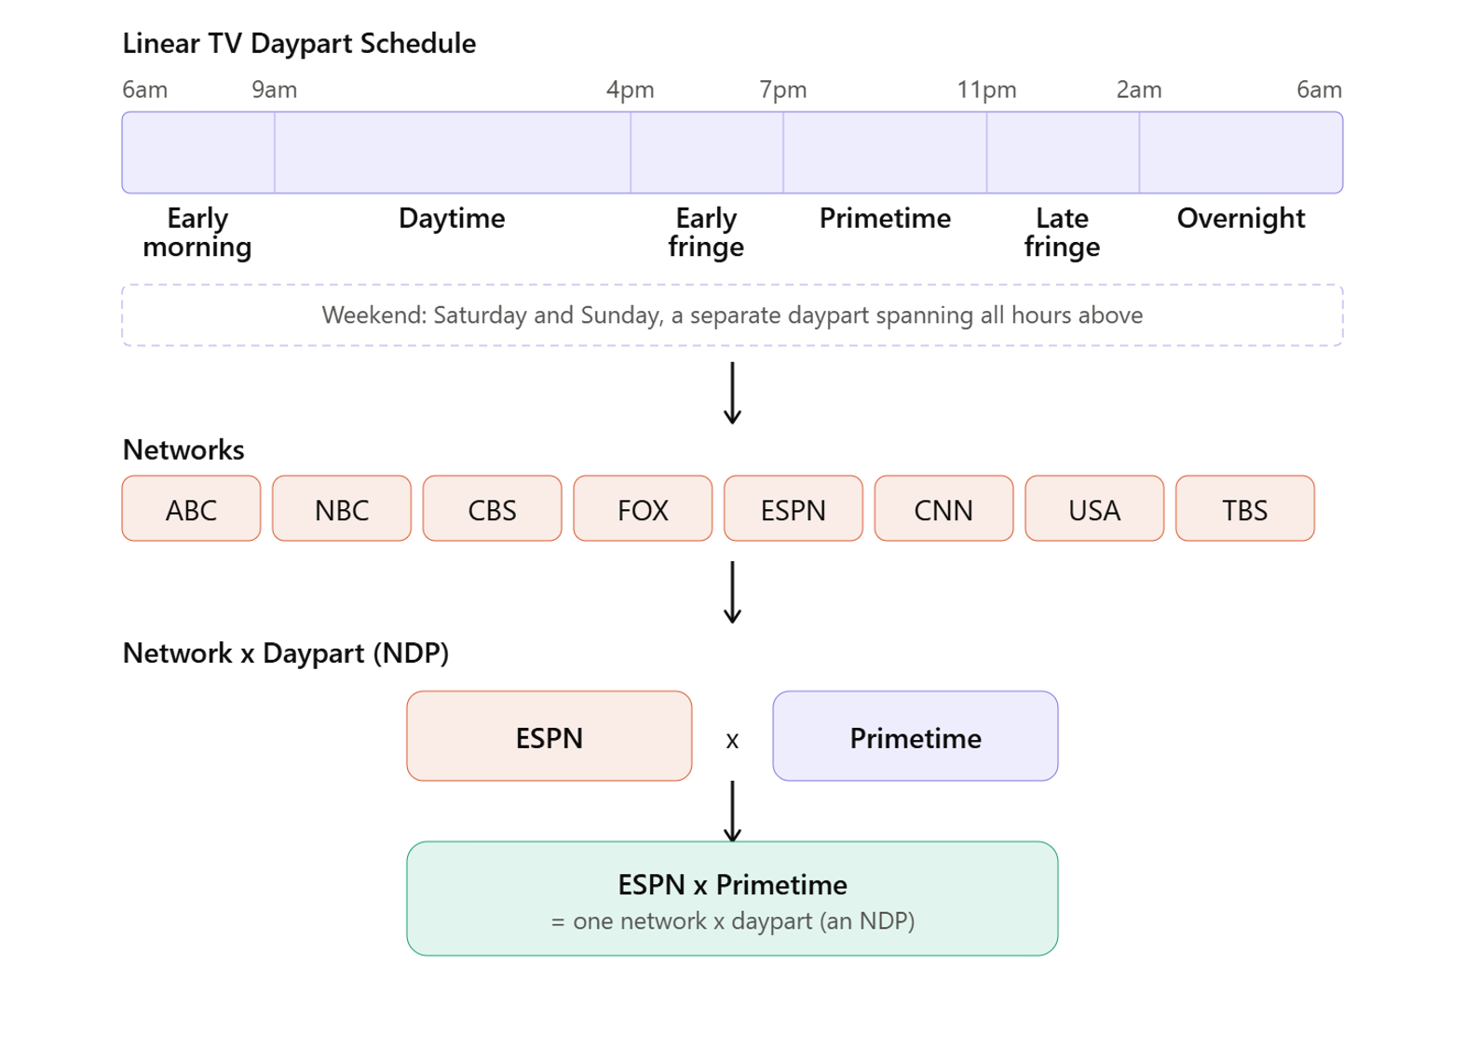
NDPs are unique units of Network x Daypart combinations on which DT ads are aired

Slide 15
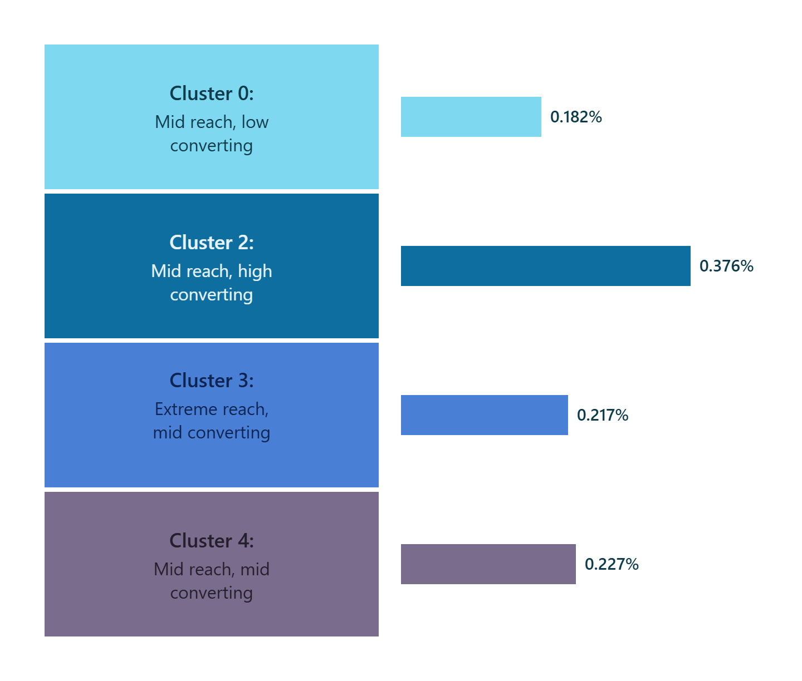
NDPs were grouped into behavioral clusters
Conversion Rate (%)
Notes:
Schedule of daypart, add example of a network
Axis label
Names of clusters
Check cluster 4

Slide 16
Top-performing NDP models still underperforming
Model Version | Lift
Baseline | 7.77x
Conversion Clusters - 4 | 3.85x
Cluster 2 | 7.45x
Notes:
Change lighter green to be more stark

Slide 17
Adding features to the model will increase its predictive power

Slide 18
Demographics exploration identified populations with strong relationship to conversion
Segment demographics by aligning with leads
Check conversion rate by segment
Run model iterations with approved features
Identify segments with strong impact
Income $0 - $50K
Age 55+

Slide 19
Sparsity of demographics data and overall structure devolved model performance
Model Version | Lift
Baseline | 7.77x
Demographics | 6.74x
Age 55+ | 6.53x
Income 0-50K | 6.44x

Slide 20
While relationships were sensible and supported, introducing features to model hurt performance
Room for Improvement
Combine features
Interaction
Model build
Feature engineering

Slide 21
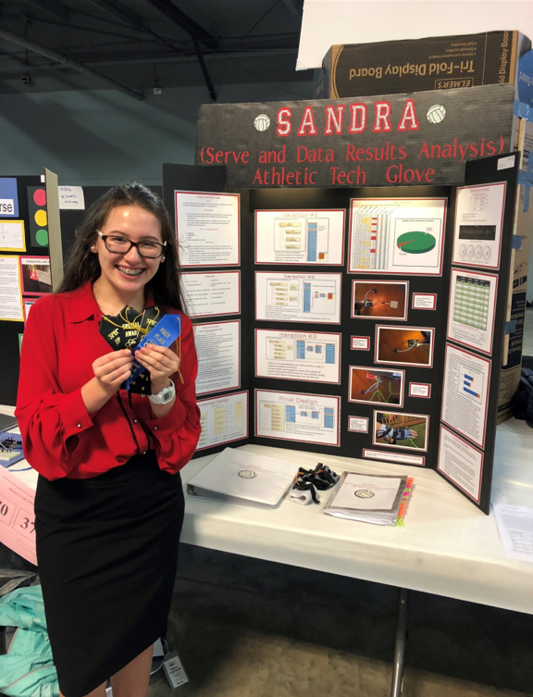
Findings beyond the results
 | Chasing down the “why” |  | Behavior and edge cases
 | Each “wrong” path boosted understanding |  | Intuition
 | Practical business |  | Work behind the work
AzSEF
SARSEF
AZ Invention Convention
& thank you!
Notes:
Add a more “this is the end”

Slide 22
Appendix

Slide 23
What is CIIM?

Slide 24
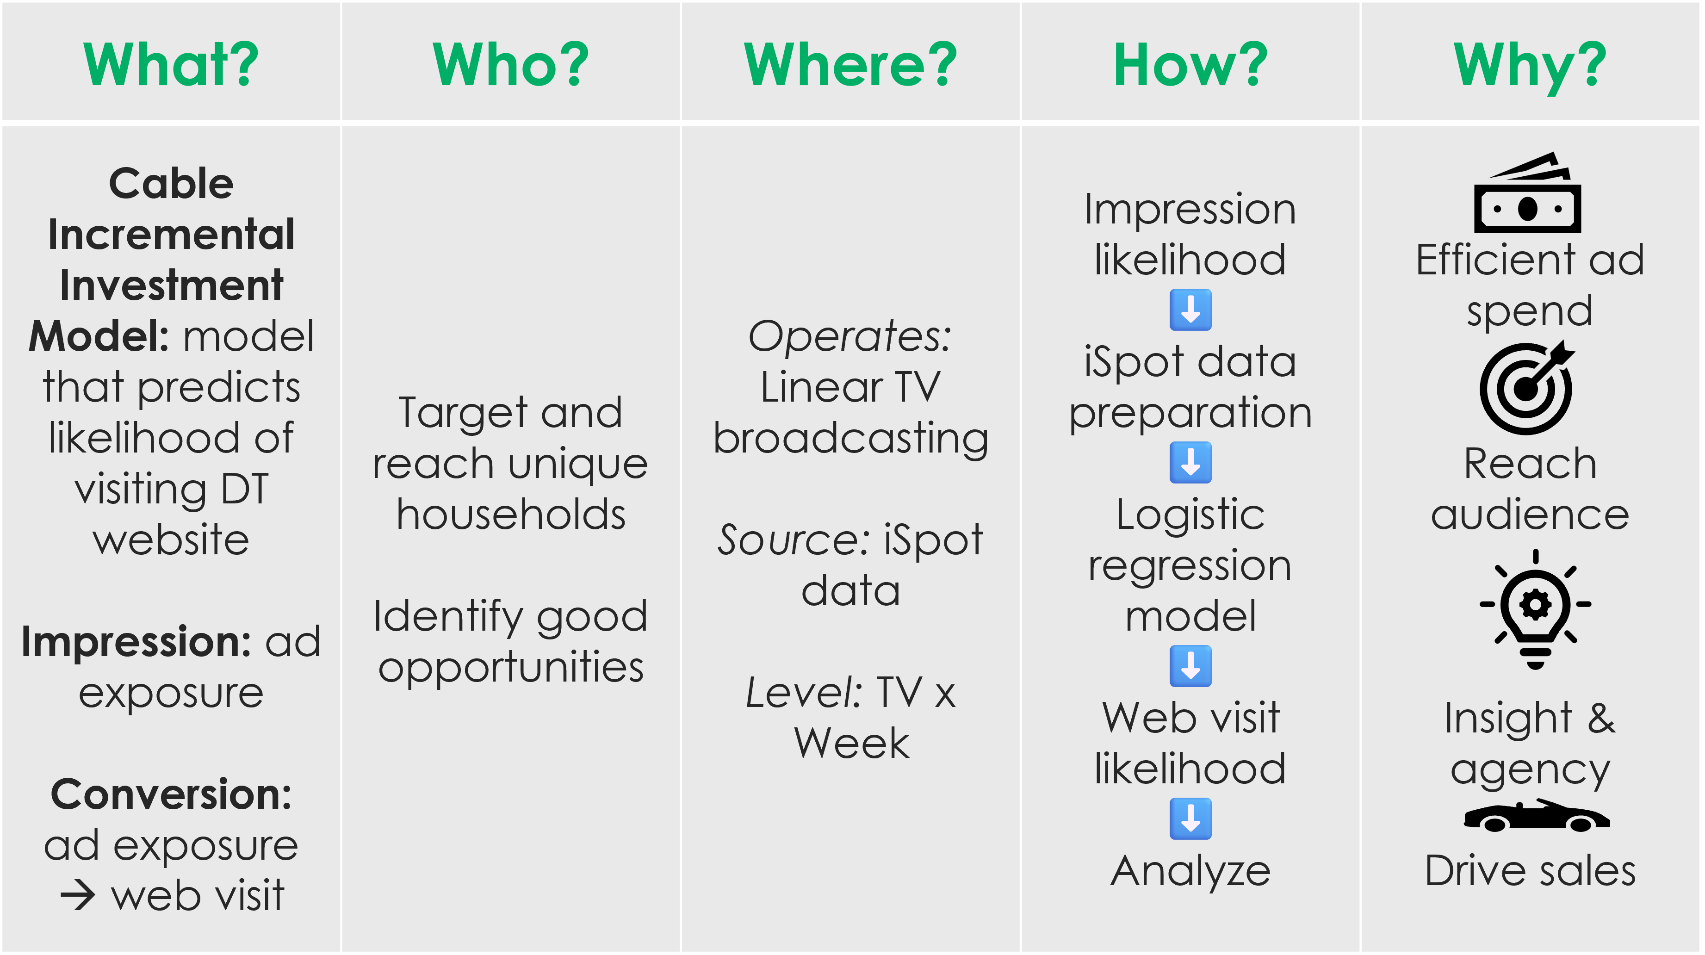
CIIM uses ad volume to predict web visit likelihood

Slide 25
Records are at TV x Week granularity
IMP_WM[x]: Number of impressions (ad exposures) from Week Minus [x] w.r.t. Broadcast Week
TV ID | BROADCAST WEEK yyyy - ww | IMP_WM0 | IMP_WM1 | IMP_WM2 | IMP_WM3 | CONVERSION
TV 1 | 2024-47 | 0 | 1 | 1 | 1 | 0
TV 1 | 2024-48 | 0 | 0 | 1 | 1 | 0
TV 1 | 2024-49 | 3 | 0 | 0 | 1 | 0
TV 1 | 2024-50 | 0 | 3 | 0 | 0 | 0
TV 1 | 2024-51 | 0 | 0 | 3 | 0 | 0
TV 1 | 2024-52 | 1 | 0 | 0 | 3 | 1
TV 2 | 2024-01 | 2 | 0 | 0 | 0 | 0
TV 2 | 2024-02 | 1 | 2 | 0 | 0 | 0
TV 2 | 2024-03 | 0 | 1 | 2 | 0 | 0
TV 2 | 2024-04 | 1 | 0 | 1 | 2 | 0

Slide 26
iSpot ad measuring platform provides TV data
IULD
Integrated User-Level Data
TV ID Broadcast Week Impression Timestamp IP Address Impression Event Info Creative Elements Network Elements Demographic Info
Panel Weights
How much is this TV “worth” on a national scale?
Conversion
Connect an impression event to a web visit

Slide 27
State of the Model

Slide 28
Logistic regression emphasizes current week impressions for predicting web visits

Slide 29
Conversion predictions globally aligned

Slide 30
When zooming in, model shows gaps in accuracy and consistency

Slide 31
Pre-Launch Checks

Slide 32
Initial data checks and exploration laid groundwork for understanding feature analyses
Understand TV identity and behavior
Focus on TVs with a long enough history
Shift calibration method to not need a specific period to match
Discuss marketing tactics
Check alignment of average conversion rate
Measure change in impression metrics
Define conversion rate and instances of behavior
Investigate data availability, sources, and structure

Slide 33
TVs experience different classifications due to different behaviors and changing guidelines
Filter to focus on primary TVs without losing sample size or signal that might come from other behaviors

Slide 34
2026 dropped network investment
2025 | Feature | 2026
7 | Dayparts | 7
75 | Networks | 62
313 | NDPs | 246
51 (ON) – 32 (EM) → 19 | Range of Network Distribution | 40 (DA) – 29 (EM) → 11
1,083,289 | Unique TVs | 1,051,339
52 | Weeks Covered | 14
20 | Minimum Weeks of Impressions | 5

Slide 35
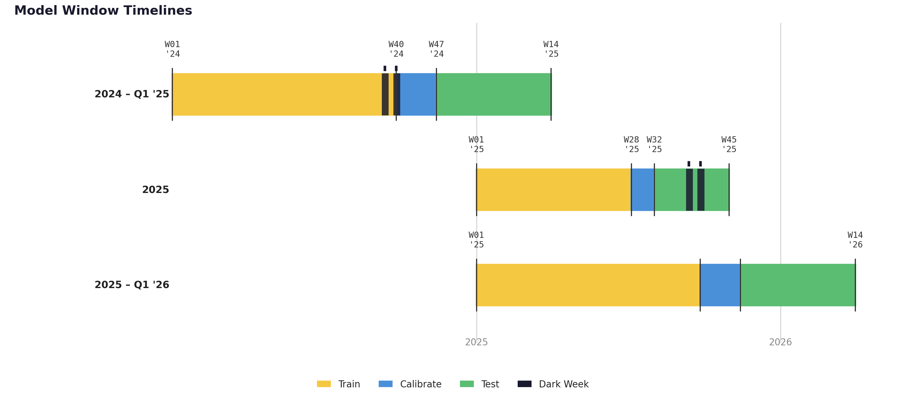
Conversion Model 2.0 tests on new timeframe and marketing regime
Learn patterns from historical data
Calibrate to match reality and adjust unknowns
Test and evaluate on unseen data
Model deployment

Slide 36
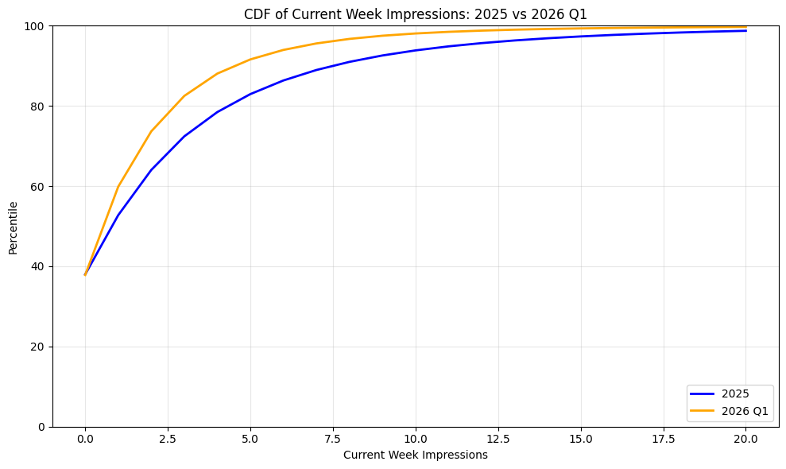
2026 shifting to lower levels of impressions
95%
82%

Slide 37
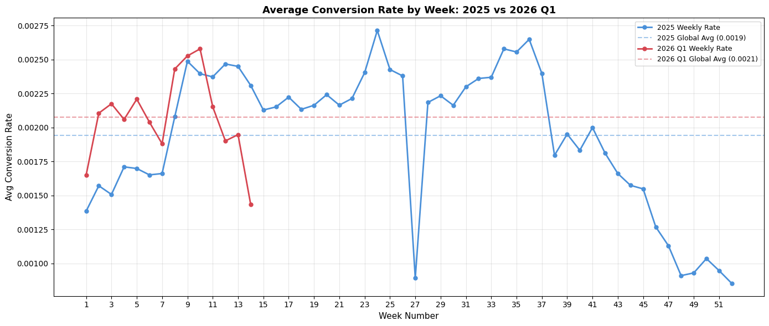
Underlying conversion behavior stable between 2025 and 2026

Slide 38
Target Feature Analysis

Slide 39

Successful features are like a SQUID…
Signal
Relationship with target
Unique
Unique information to model
Insight
Actionable and interpretable
Differences between groups
Aligns with business knowledge
Durability
Quality
Meaningfully improve key metrics
Elastic with changes in regime and behavior
Avoid overfitting
Generalizes well

Slide 40

$H_{\text{α}}$: Monthly impression data missed details of conversion in temporal patterns and distribution
Signal | Unique Information | Features + Outcomes
✅ | ❌ | 9 Features – Repackaged Impressions → ❌
❌ | ✅ | Is New Exposure – No Relationship with Model Target → ❌
✅ | ✅ | Daytime Share – Not Distinct Enough Signal → ❌
❌ | ❌ | 7 Features – No Pass → ❌

Slide 41
Seasonality

Slide 42
Recommend maintaining Baseline Model
 | Baseline Model | Seasonal @ C = 1 | Seasonal @ C = 0.5 | Seasonal @ C = 0.25 | Quarter
AUC | 0.607 | 0.581 | 0.599 | 0.605 | 0.601
Weekly MAPE | 13.89% | 15.25% | 14.19% | 13.59% | 14.96%
Top/Bottom Spread | 7.77x | 3.38x | 3.95x | 4.76x | 6.42x

Slide 43
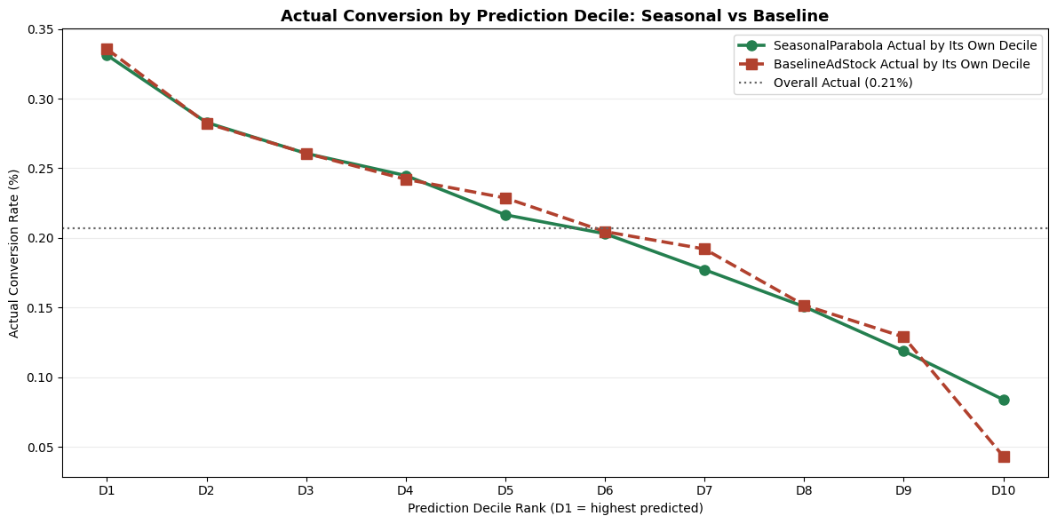
Seasonal Model fails to outperform Baseline Model

Slide 44
Network Dayparts

Slide 45
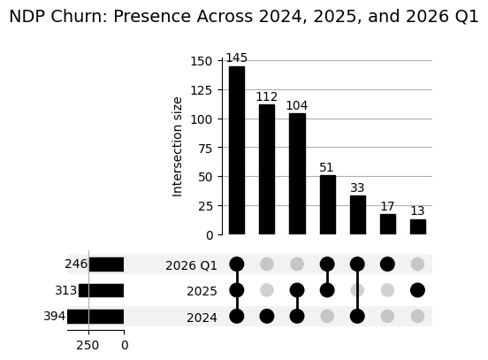
NDP-level features present a variety of challenges
Daypart: specific block of time for TV broadcasting to target audiences

Slide 46
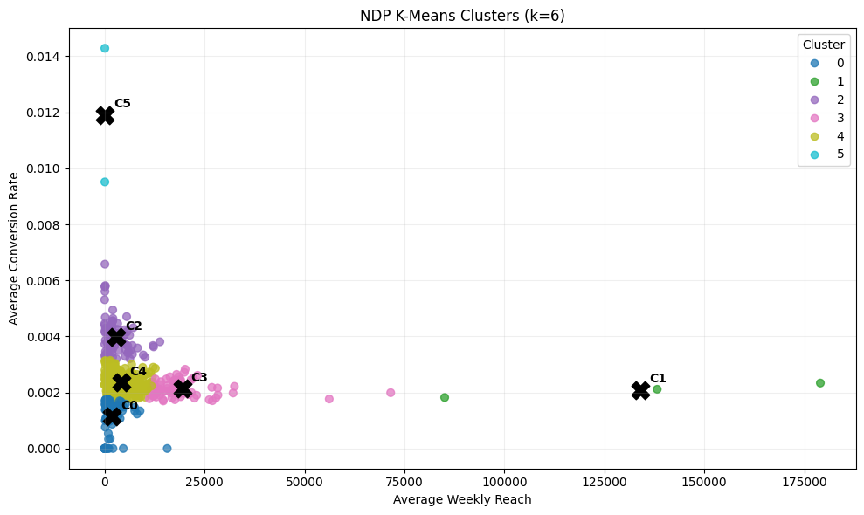
K-Means Clustering creates 6 groups that collapse to 4 with mapping techniques

Slide 47
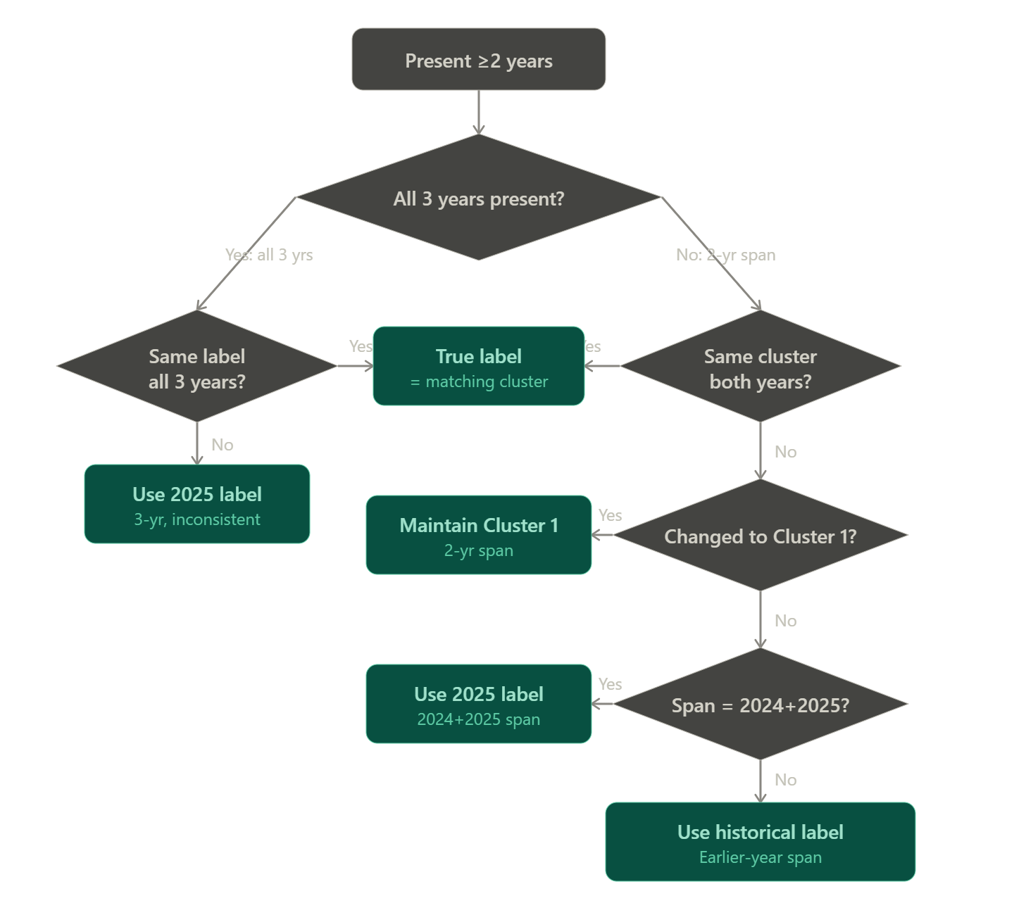
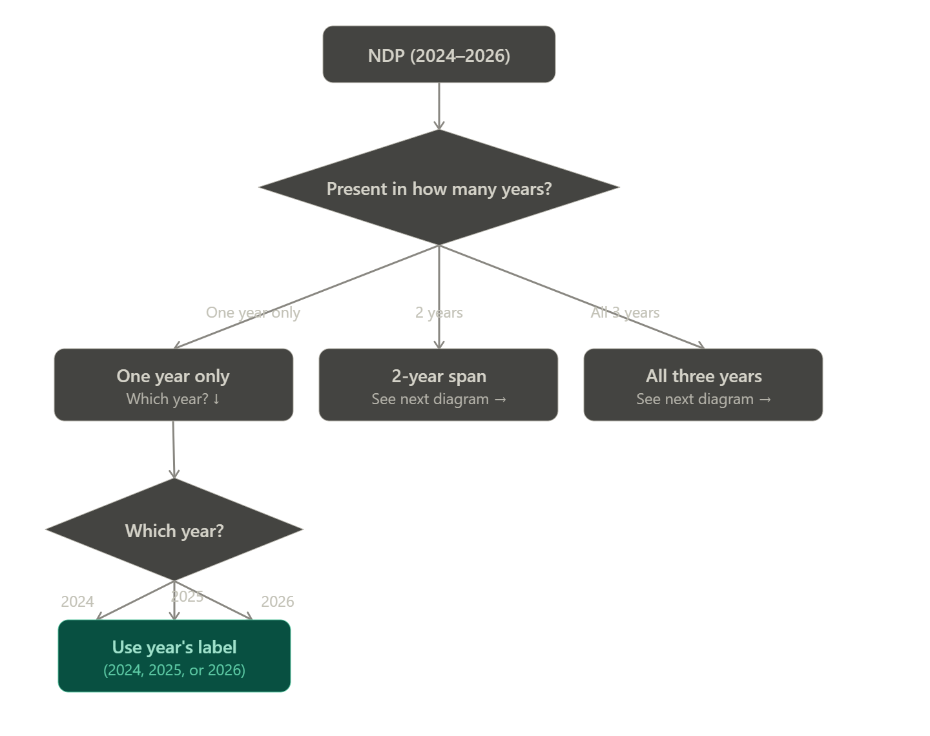
Mapping decisions
Cluster | C0 (ML) | C2 (MH) 2 “C5” | C3 (EM) 1 “C1” | C4 (MM)
# NDPs | 67 | 64 | 34 | 206
Conversion TV x Week x NDP | 0.182% | 0.376% | 0.217% | 0.227%

Slide 48
Recommend maintaining baseline model
 | Baseline Model | Exclusive Clusters | Conversion Clusters v2 Update Map | Conversion Clusters v3 3 Clusters | Conversion Clusters v4 Only C2 | Conversion Clusters v5 Only C0
Test AUC (Train AUC) | 0.6072 (0.594) | 0.604 | 0.6073 | 0.6073 | 0.6105 (0.6002) | 0.601
Weekly MAPE | 13.89% | 13.38% | 15.34% | 15.25% | 14.34% | 15.16%
Most Impactful Feature | IMP_WM0 | IMP_WM0 | PCT_CLUSTER2 | PCT_CLUSTER2 | IMP_WM0 | IMP_WM0
Top/Bottom Lift Actuals | 7.77x | 6.86x | 3.85x | 3.86x | 7.45x | 3.46x

Slide 49
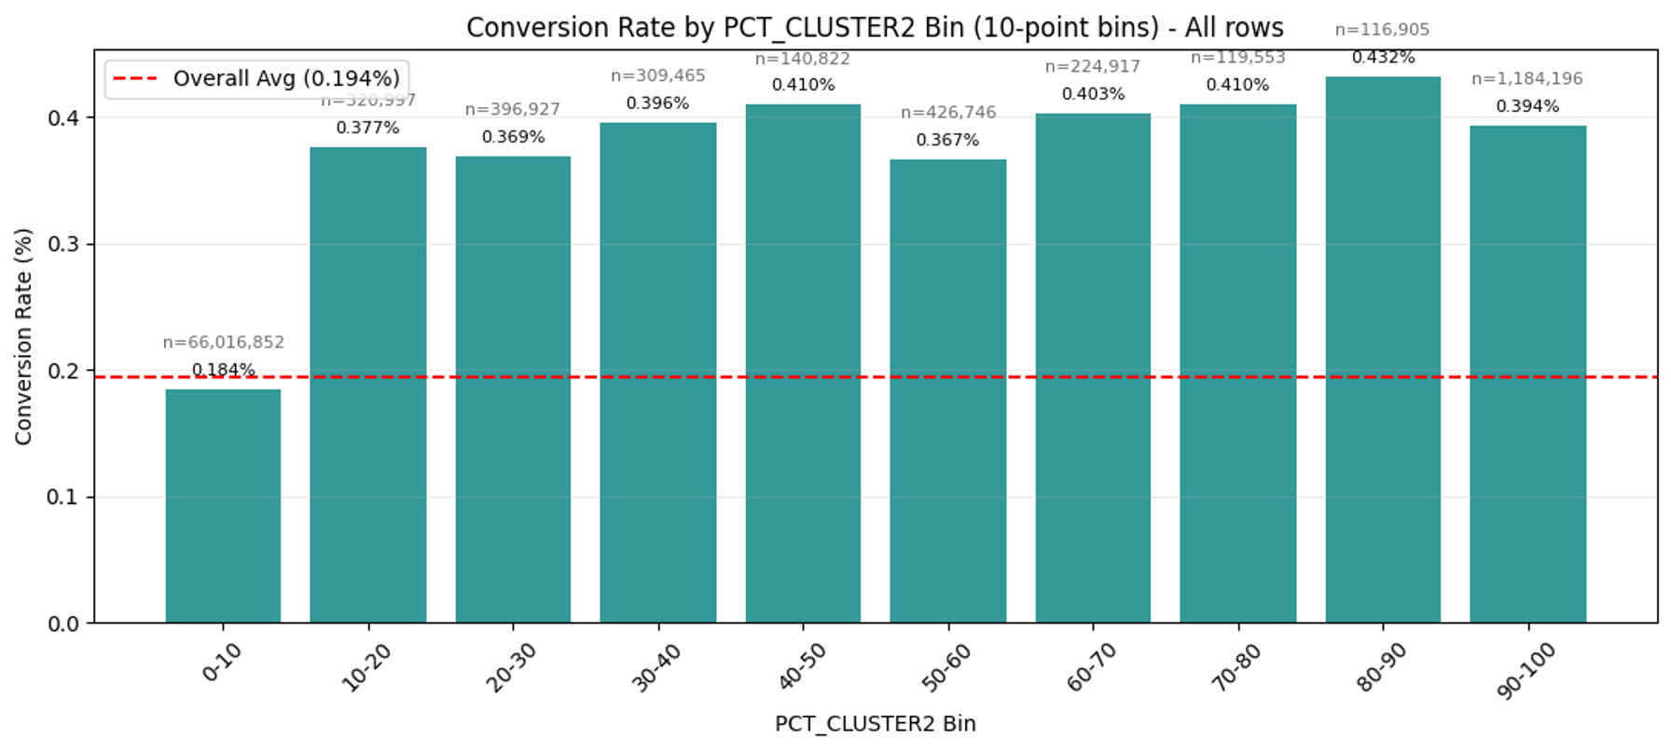
Cluster 2 Feature fails on 3 fronts
Non-linear Relationship | Unclear Definitions | Underlying Potential for Error

Slide 50
Income

Slide 51
Less extreme variation in conversion rate by income

Slide 52
Better performance for income 0-50K persists in sample
Group Number | Has Demographic Data? | Income 0-50K? | Number of Records (Train + Test) | Train Rank (Conv) | Test Rank (Conv) | Conversion Rate (%)
1 | ✅ | ❌ | 10,671,958 | 1 | 1 | 0.1700%
2 | ❌ | ❌ | 55,001,292 | 2 | 2 | 0.1997%
3 | ✅ | ✅ | 53,76,524 | 3 | 3 | 0.2235%

Slide 53
Recommend maintaining baseline model; all model versions struggle with lift
 | Baseline Model | Has Demo Data + Income 0-50K | Income 0-50K | Has Demo Data
Test AUC (Train AUC) | 0.6072 (0.594) | 0.6088 (0.595) | 0.6079 (0.594) | 0.6073 (0.594)
Weekly MAPE | 13.89% | 14.28% | 14.34% | 13.97%
Most Impactful Feature | IMP_WM0 | IMP_WM0 | IMP_WM0 | IMP_WM0
Top/Bottom Lift Actuals | 7.77x | 6.21x | 6.44x | 6.41x

Slide 54
Age

Slide 55
Clear discrepancy in continuation of age relationship
55

Slide 56
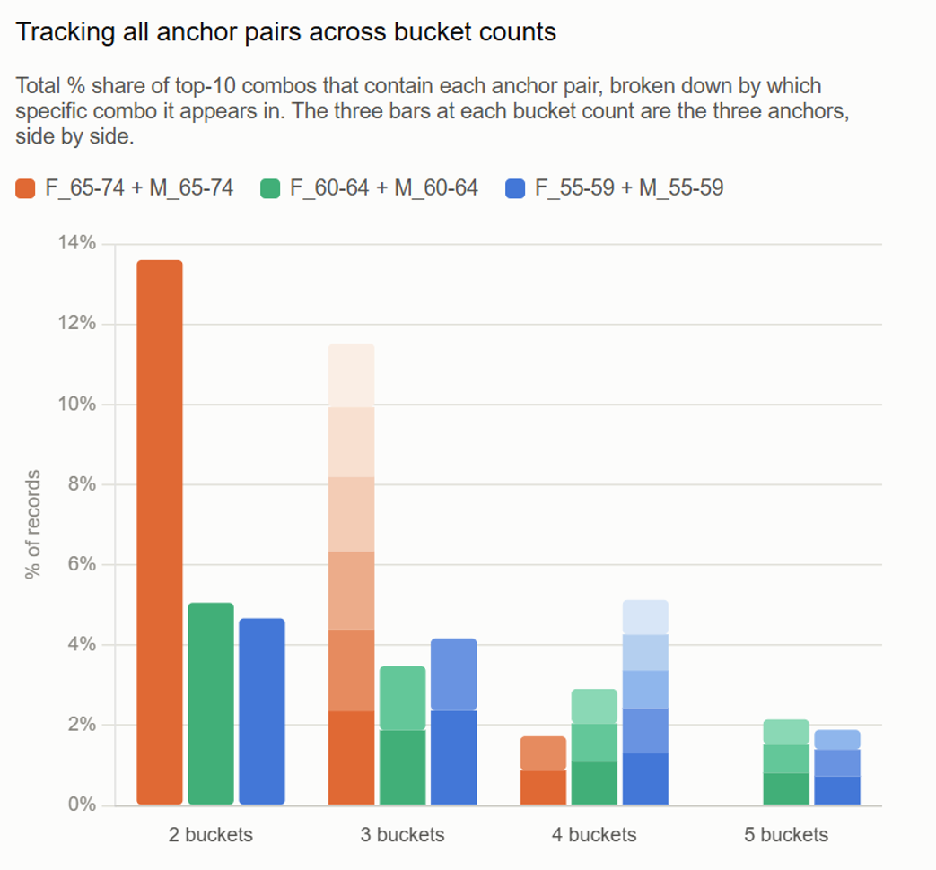
55+ Records consistently containing multiple ages
 | 2 | 3 | 4 | 5
Unique Combos | 276 | 1,859 | 4,451 | 2,956
Top 10 from 55+ | 8 | 10 (RGB) | 10 (RGB) | 10 (RGB)
% of All Records covered by Top 10 Combos | 19% | 1.96% | 0.24% | 0.02%
Number of Records | 42M | 12M | 2M | 400K

Slide 57
Households that are only 55+ perform worse; indicating household makeup helps distinguish
Group Number | Has Demographic Data? | Is 55+? | Household Age Buckets | Number of Records (Train + Test) | Train Rank (Conv) | Test Rank (Conv) | Conversion Rate (%)
1 | ✅ | ✅ | 1 | 8,307,874 | 2 ⬆️ | 1 | 0.1797%
2 | ✅ | ✅ | 2 | 2,763,266 | 3⬆️ | 2 | 0.1809%
3 | ✅ | ✅ | 3 | 338,042 | 5⬆️ | 3 | 0.1867%
4 | ✅ | ❌ | 2 | 451,858 | 4 | 6⬆️ | 0.1908%
5 | ✅ | ❌ | 1 | 4,550,498 | 6⬆️ | 4 ↓ | 0.1987%
6 | ❌ | ❌ | 0 | 54,594,682 | 7⬆️ | 5 ↓ | 0.2004%
7 | ✅ | ✅ | 4 | 19,058 | 1 ↓ | 8⬆️ | 0.2099%
8 | ✅ | ❌ | 3 | 24,496 | 8 | 7 ↓ | 0.2858%

Slide 58
Recommend maintaining baseline model; all model versions struggle with lift
 | Baseline Model | Has Demo Data | Has Demo Data & Age 55+ | Age 55+ | Has Demo Data & Age 55+ & Household Ages | Age 55+ & Household Ages
Test AUC (Train AUC) | 0.6072 (0.594) | 0.6073 | 0.6076 (0.594) | 0.6077 (0.594) | 0.6079 (0.594) | 0.6075 (0.593)
Weekly MAPE | 13.89% | 13.97% | 13.94% | 13.96% | 13.96% | 13.97%
Most Impactful Feature | IMP_WM0 | IMP_WM0 | IMP_WM0 | IMP_WM0 | IMP_WM0 | IMP_WM0
Top/Bottom Lift Actuals | 7.77x | 6.41x | 6.53x | 6.53x | 2.19x | 6.45x

